Slide 1

Department of BES-II
BASIC ELECTRICAL & ELCTRONIC CIRCUITS (BEC)
COURSE CODE : 23EC1201
Topic:
Op-aMP ic 741
Session – SA-4

Slide 2



AIM OF THE SESSION
To familiarize students with the basic concept of Op-Amp IC 741
INSTRUCTIONAL OBJECTIVES
This Session is designed to:
Demonstrate the basic concept of Op-Amp IC 741
Describe the concept of Op-Amp IC 741
List out the importance of Op-Amp IC 741
LEARNING OUTCOMES
At the end of this session, you should be able to:
Define the concept of Op-Amp IC 741
Describe the detailed concept of Op-Amp IC 741
Summarize the concept of Op-Amo IC 741

Slide 3
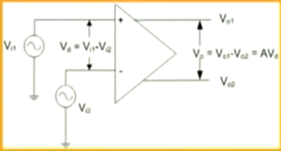
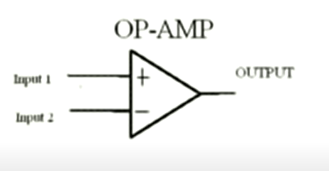
SESSION INTRODUCTION
An operational amplifier, or op amp, is a versatile electronic device that can perform various mathematical operations on analog signals, such as addition, subtraction, multiplication, integration, differentiation, and more.
An op amp is a DC-coupled high-gain voltage amplifier with a differential input and a single output.
It can be used as a building block for many analog circuits, such as filters, oscillators, comparators, amplifiers, and so on.

Slide 4
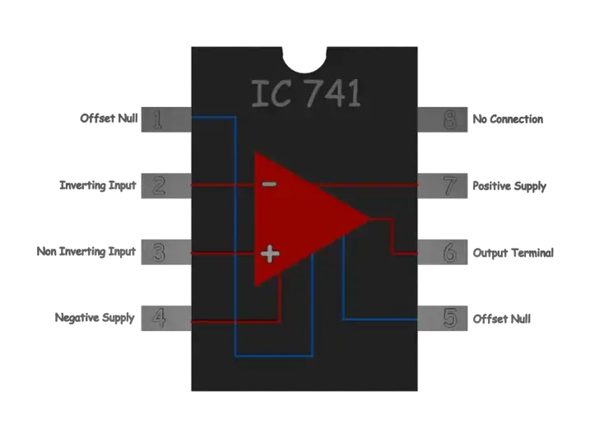
SESSION DESCRIPTION
An IC 741 op-amp is defined as a monolithic integrated circuit that contains a single operational amplifier.
It is packaged in an 8-pin dual-in-line (DIP) plastic or metal case.
The IC 741 op amp has three main terminals: an inverting input (pin 2), a non-inverting input (pin 3), and an output (pin 6)
It also has two power supply terminals: a positive supply (pin 7) and a negative supply (pin 4).
Additionally, it has two offset null terminals (pin 1 and pin 5) that can be used to adjust the input offset voltage to zero by adding an external potentiometer.
Fig. 2. Pin diagram of Operational Amplifier.

Slide 5
SESSION DESCRIPTION (Cont..)
Pin Number | Pin Name | Pin Function
1 | Offset Null | Used to adjust the input offset voltage to zero
2 | Inverting Input | Receives the negative or inverted input signal
3 | Non-Inverting Input | Receives the positive or non-inverted input signal
4 | Negative Supply | Connected to the negative voltage source
5 | Offset Null | Used to adjust the input offset voltage to zero
6 | Output | Provides the amplified output signal
7 | Positive Supply | Connected to the positive voltage source
8 | NC (No Connection) | No connection

Slide 6
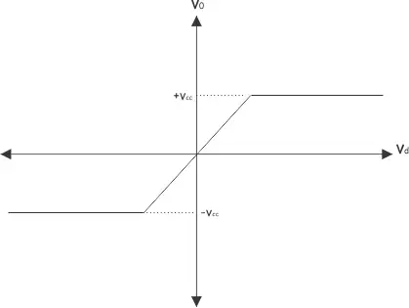
SESSION DESCRIPTION (Cont..)
Fig. 3. Op-Amp characteristics with negative feedback.

Slide 7


SESSION DESCRIPTION (Cont..)
Important Characteristics of Op-Amp
Open-loop gain: This is the gain of the op-amp without any feedback. It is typically very high, ranging from 105 to 108.
Input impedance: This is the resistance that the op-amp presents to the input signal. It is typically very high, ranging from 105 to 1013 ohms.
Output impedance: This is the resistance that the op-amp presents to the output load. It is typically very low, ranging from 10 to 100 ohms.
Offset voltage: This is the voltage difference between the inverting and non-inverting inputs when the output voltage is zero.
Slew rate: This is the maximum rate of change of the output voltage per unit time. It is usually expressed in volts per microsecond (V/µs).
Bandwidth: This is the range of frequencies that the op-amp can amplify without significant attenuation or distortion
Common-mode rejection ratio (CMRR): This is a measure of how well the op-amp can reject signals that are common to both inputs

Slide 8
SESSION DESCRIPTION (Cont..)
Important Applications of Op-Amp
Voltage follower: This is a circuit that produces an output voltage that is equal to the input voltage. It is also known as a buffer or an isolation amplifier.
Inverting amplifier: This is a circuit that produces an output voltage that is proportional and opposite to the input voltage.
Non-inverting amplifier: This is a circuit that produces an output voltage that is proportional and the same as the input voltage.
Summing amplifier: This is a circuit that produces an output voltage that is proportional to the sum of two or more input voltages.
Differential amplifier: This is a circuit that produces an output voltage that is proportional to the difference between two input voltages.
Integrator: This is a circuit that produces an output voltage that is proportional to the integral of the input voltage with respect to time.
Differentiator: This is a circuit that produces an output voltage that is proportional to the derivative of the input voltage with respect to time.

Slide 9

ACTIVITIES/ CASE STUDIES/ IMPORTANT FACTS RELATED TO THE SESSION
The Input impedance of the IC 741 op amp is above 100kilo-ohms.
The o/p of the 741 IC op amp is below 100 ohms.
The frequency range of amplifier signals for IC 741 op amp is from 0Hz- 1MHz.
The offset current and offset voltage of the IC 741 op amp is low

Slide 10
SUMMARY
The IC 741 op amp is a versatile and widely used electronic device that can perform various mathematical operations on analog signals.
It has many features that make it suitable for a wide range of applications, such as high input impedance, low output impedance, short-circuit protection, internal frequency compensation, and low offset voltage.

Slide 11
SELF-ASSESSMENT QUESTIONS
An Op-amp 741 has
…5 pins
…6 pins
…7 pins
…8 pins
…What is the ideal input resistance of an Op-Amp.
…Zero
…infinity
…relative resistance
…None

Slide 12
SELF-ASSESSMENT QUESTIONS
Which type of bus structre is used to connect the I/O devices
…Single
…Multiple
…Star
…Node to Node
…A special case of non-inverting amplifier in which all of the output voltage is given to inverting input of the op-amp is called
…Differentiator
…Integrator
…Logartihmic amplifier
…Voltage follower

Slide 13
TERMINAL QUESTIONS
Describe the working of an inverting op-amp with its circuit diagram.
List out the applications of 741 op-amp.
Analyze the characteristics of negative feedback op-amp
Summarize the important characteristics of 741 op-amp

Slide 14
REFERENCES FOR FURTHER LEARNING OF THE SESSION
Reference Books:
John Bird. Electrical circuit theory and technology. Routledge publisher, 6th edition
Op-amp and linear integrated circuit technology, R. A. Gayakwad.
3. David A. Bell. Electronic Devices and Circuits. 5th Edition
Sites and Web links:
1. https://www.electrical4u.com/op-amp-or-operational-amplifier-741-ic/#:~:text=An%20IC%20741%20op%2Damp,an%20output%20(pin%206).
2. https://www.elprocus.com/ic-741-op-amp-tutorial-and-characteristics/

Slide 15
THANK YOU
Team – Fundamentals of IoT & Sensors

